Slide 1

House Rent Prediction Using Machine Learning
By:
Kalyani Nikam

Slide 2
HOUSE RENT PREDICTION
01
Problem Statement
02
Data Description
03
Data Cleaning
04
Data Visualisation
05
Feature Engineering
06
Predictive Modeling
DATA SCIENCE LIFECYCLE

Slide 3
🏡 INTRODUCTION 🏡
Problem : We will rent a house from different cities and we want to predict the rent of house based on the various factors.
Solution : Collecting and analyzing data from kaggle site and predicting the house rent.

Slide 4
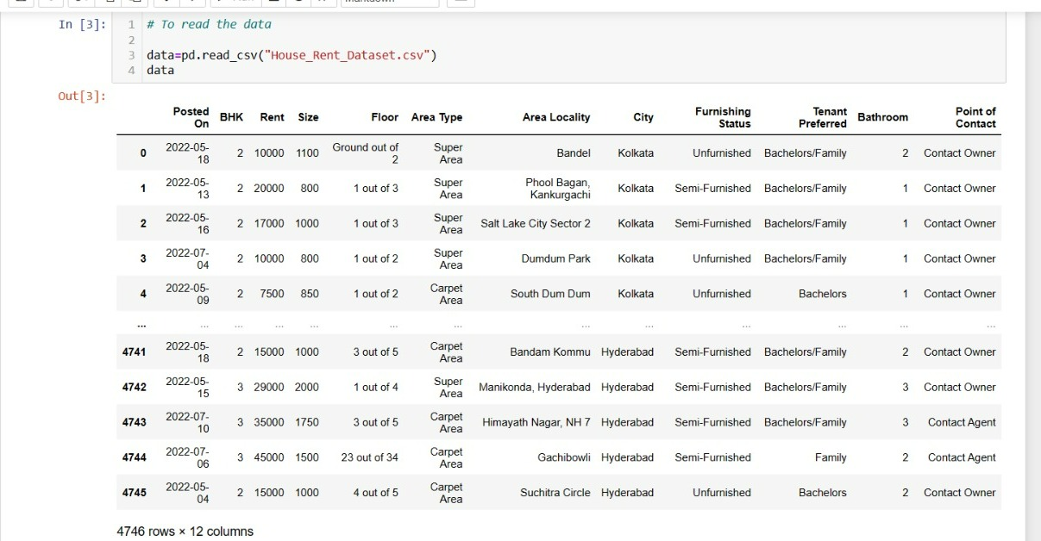
🏡 DATA DISCRIPTION 🏡
The Attributes include:
Posted On
BHK
Rent
Size
Floor
Area Type
Area Locality
City
Furnishing Status
Tenant Preferred
Bathroom
Point of Contact
Total columns = 12
Total rows = 4746

Slide 5
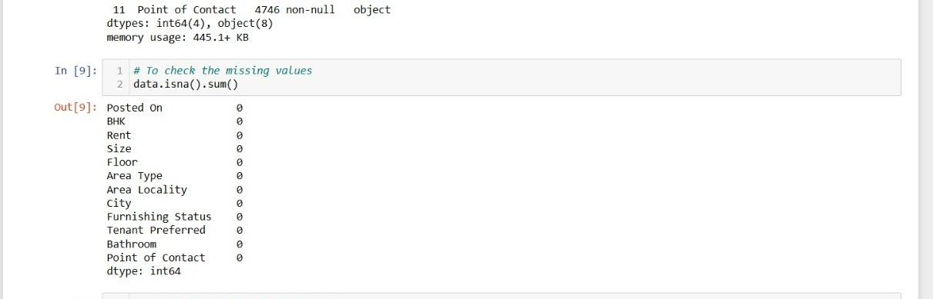
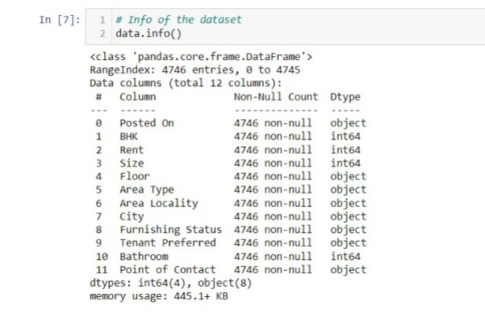
DATA CLEANING

Slide 6
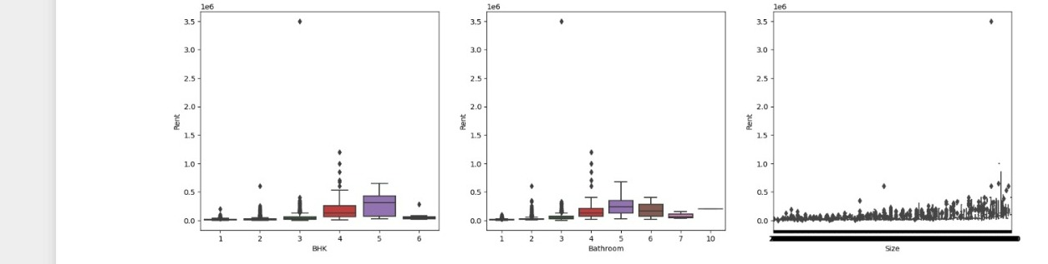
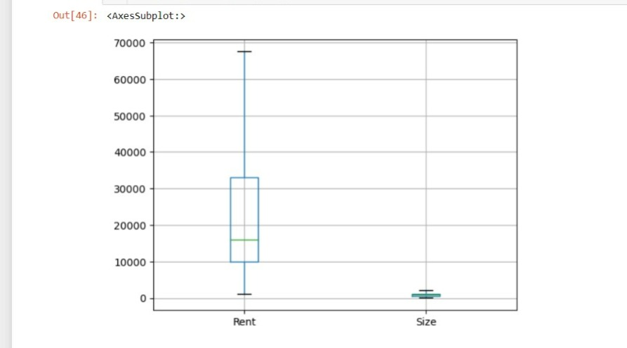
Outliers Detection and Outliers Removal with the IQR Method

Slide 7
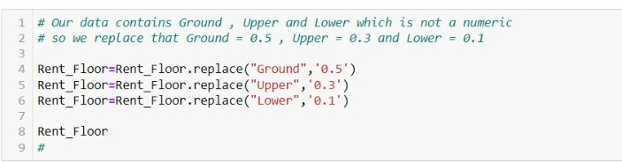
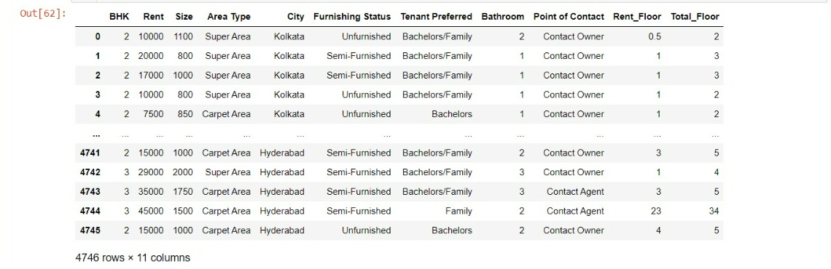
Here, our Floor column contains non numeric data so we replace it will numeric data for our further reference.
So here we add two columns after the converting non numeric data into numeric data
Previous name= Floor
New columns=
Rent_Floor and Total_Floor

Slide 8
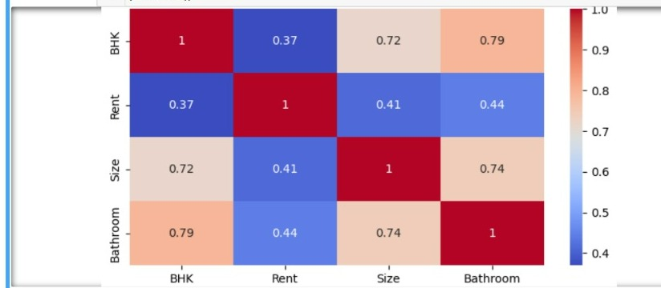
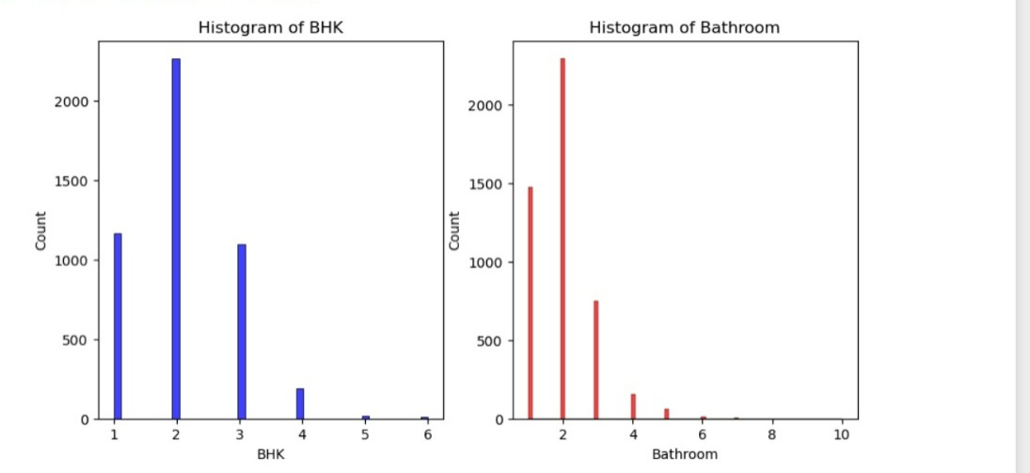
🏡 DATA VISUALISATION 🏡
CONTINUOUS VARIABLES:
BHK, Bathroom, Size ,Rent
Here we plot histogram , pairplot and heatmap

Slide 9
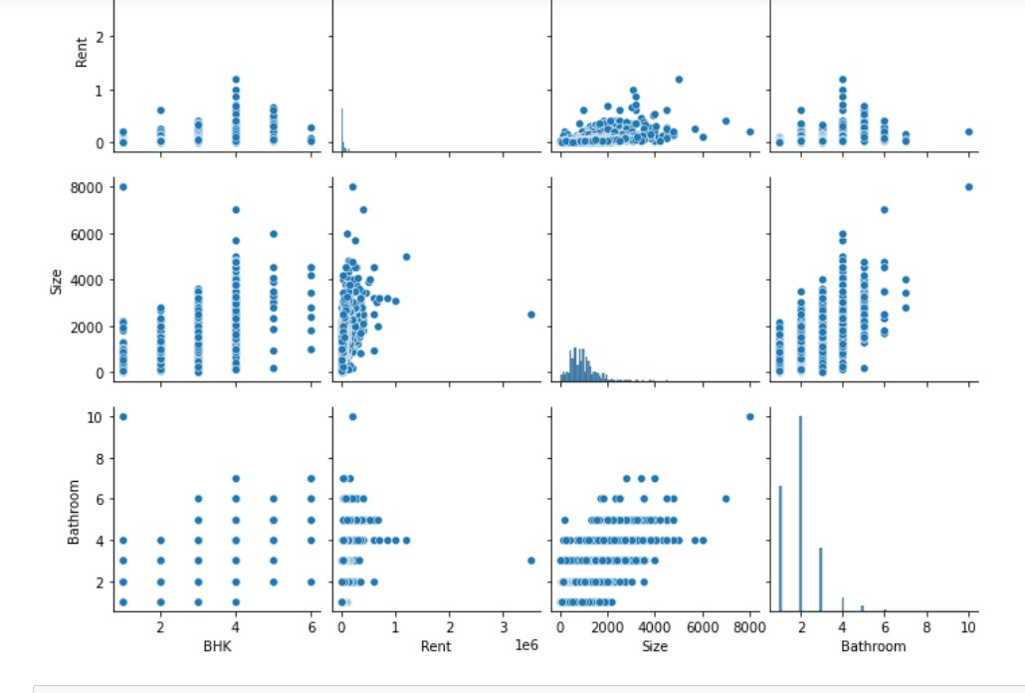
Pair plot for continuous variable

Slide 10
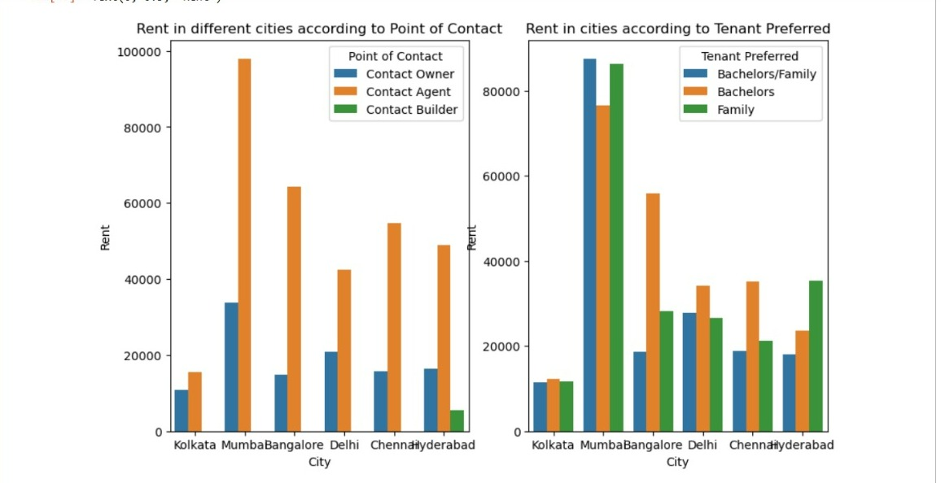
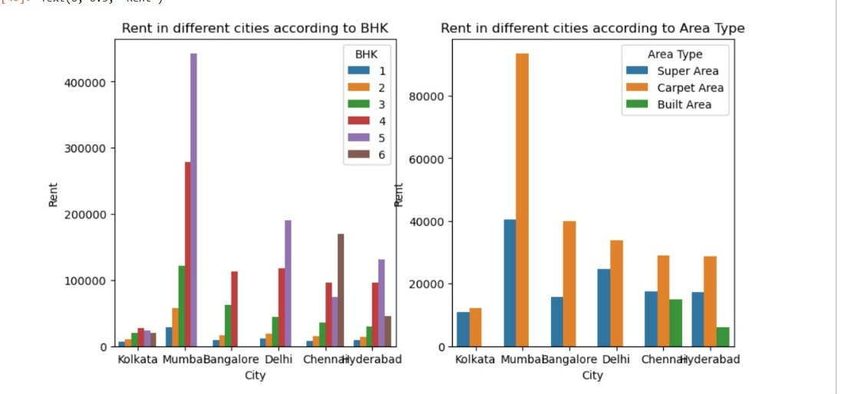
🏡 Data Visualisation of Categorical Variables and Continuous 🏡

Slide 11
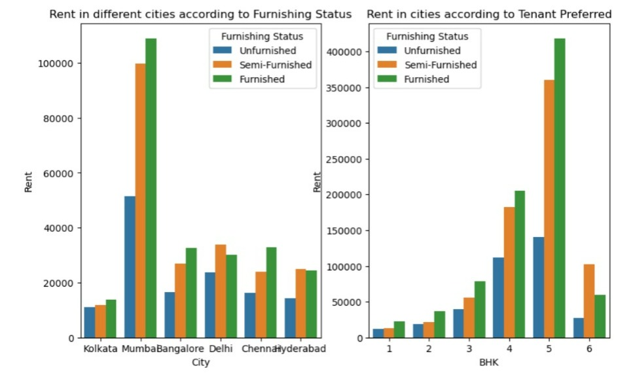
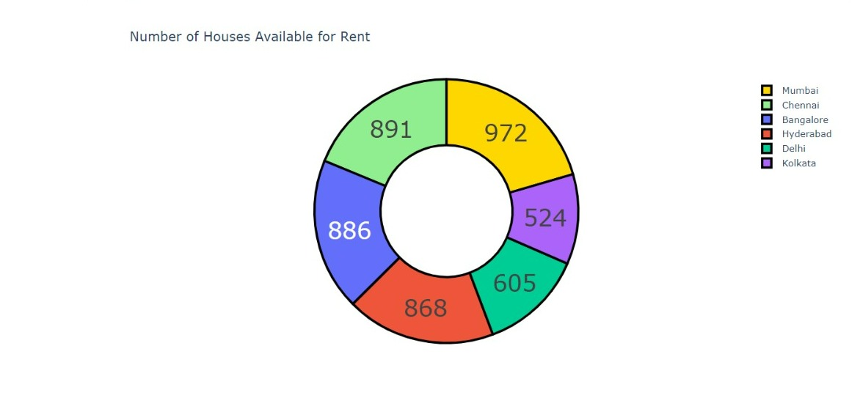
Houses available in different cities:

Slide 12
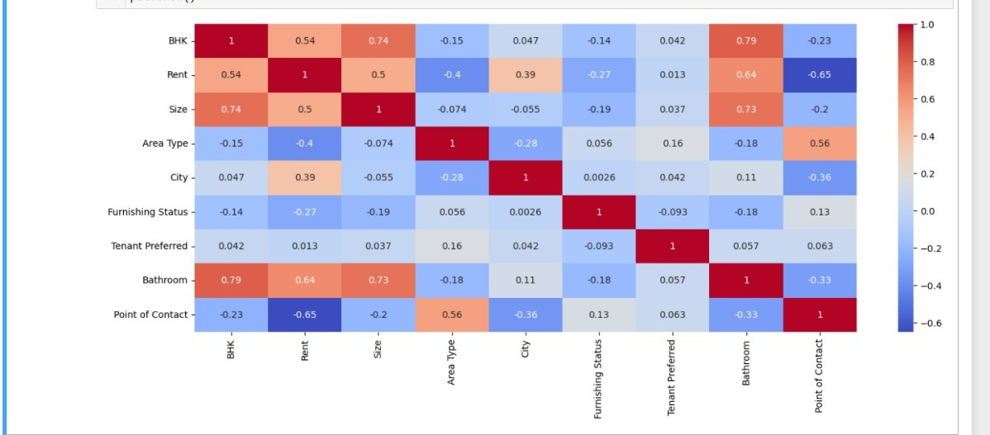
HEAT MAP OF ALL VARIABLE
Highly Significant Variables :
BHK
Size
Point of Contact
Bathroom
City
Area Type

Slide 13
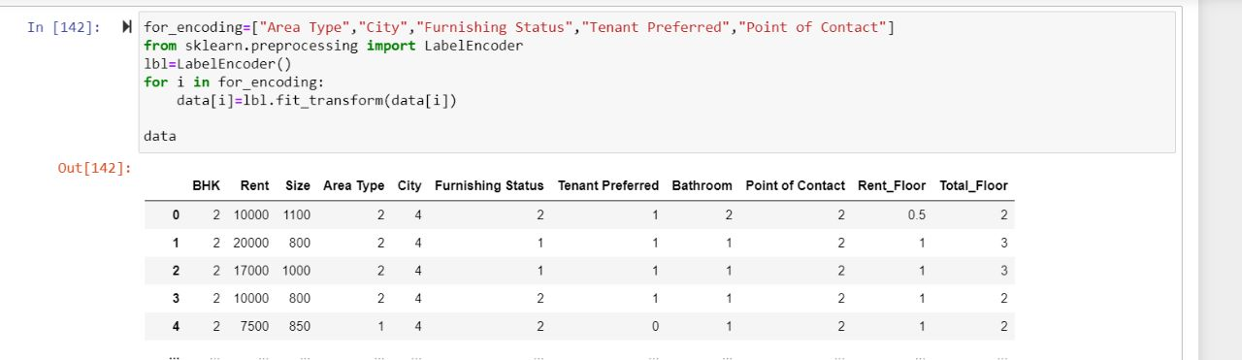
FEATURE SCALING
LABEL ENCODING :
In linear regression data should be in numeric form, so we perform label encoding for the attributes which are non numeric.

Slide 14
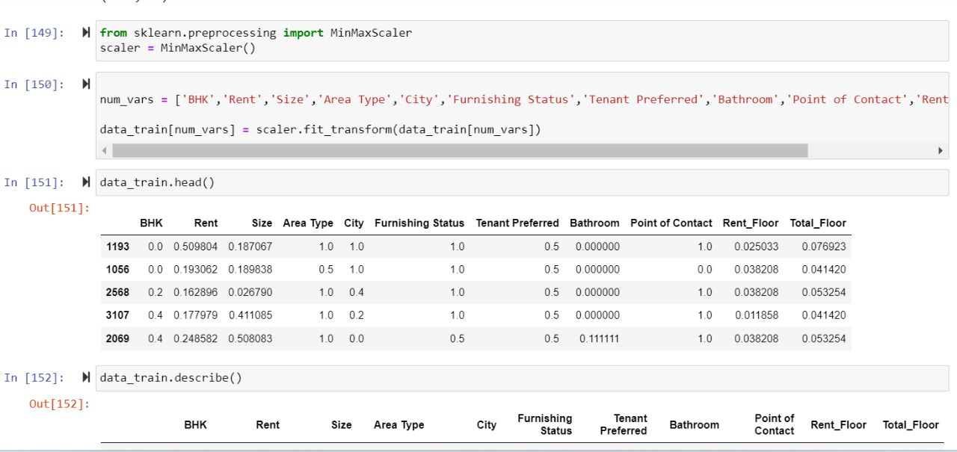
FEATURE SCALING
MinMax Scalar:
We scale all the variables with the help of minmax scalar to make all the features in the data set have a similar range, so that none of the feature dominate the others during the modeling process.

Slide 15
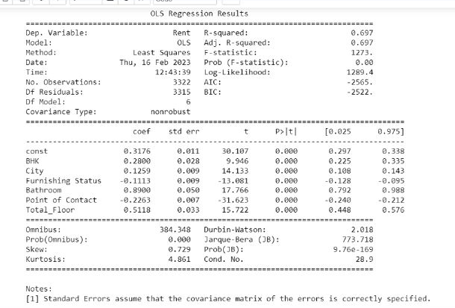
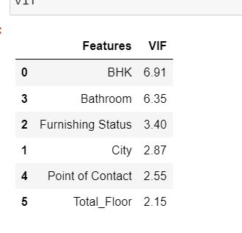
MODEL BUILDING
For model builing we use multiple linear regression to predict the rent. While building a model we find some of the variables are significant and some are not, so we remove the variables according to the P-value and VIF value.
This is the final result.

Slide 16
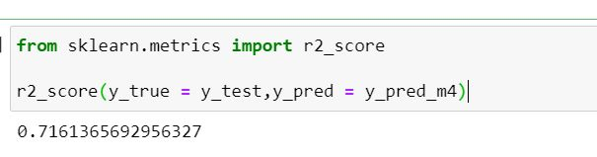
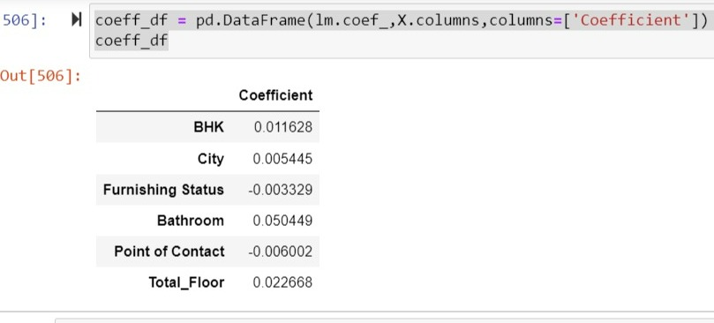
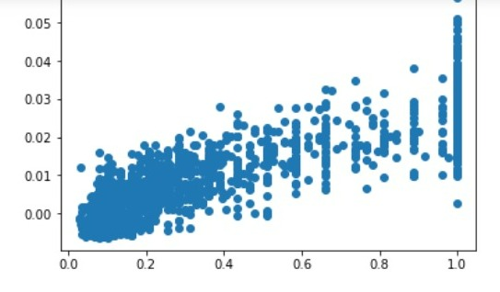
Problem Solution
After building a model we get the coefficient for significant variable from that we can make the equation for the rent prediction and the residuals are equally distributed.
Residual Plot

Slide 17

Evaluation of project
Significant variable :
BHK
City
Bathroom
Furnishing Status
Point of Contact
Total Floor
Accuracy of model : 71%
The project demonstrates the potential of machine learning to predict rental prices and provides a foundation for further research and development in this areas. The model could be deployed in a real-world scenario, such as a rental listing website or app, and could be improved through ongoing
refinement and updates.

Slide 18
Thank You

